Slide 1
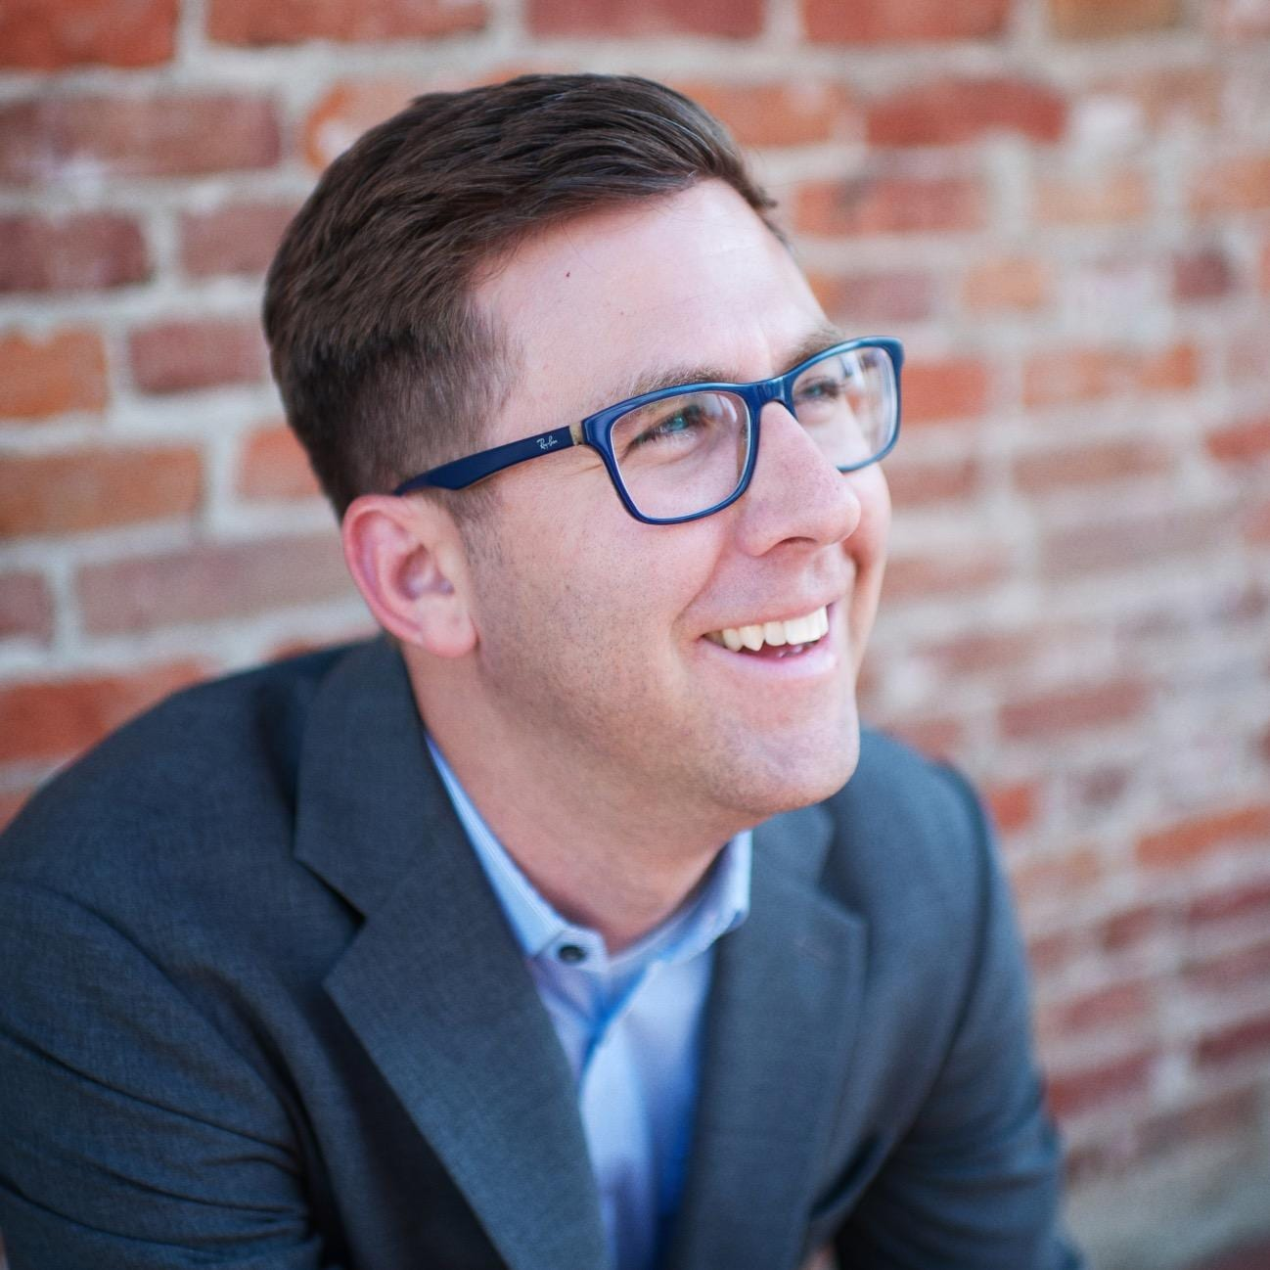
Children & Family Ministry Conference
Join with church workers and volunteers from around the LCMS for a 3 days of learning and growth focused on our ministry to children and their families.
Cost:
Deadline:
Contact:
More info: www.psd-youthandfamily.org/children-and-family

